Slide 1
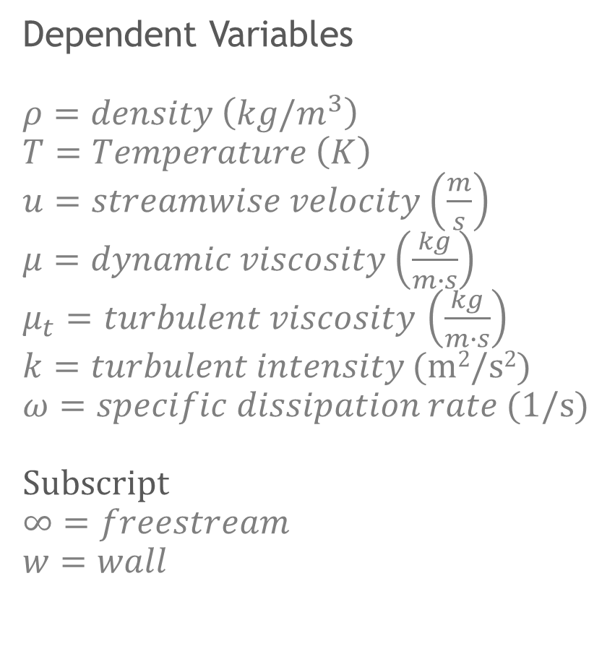
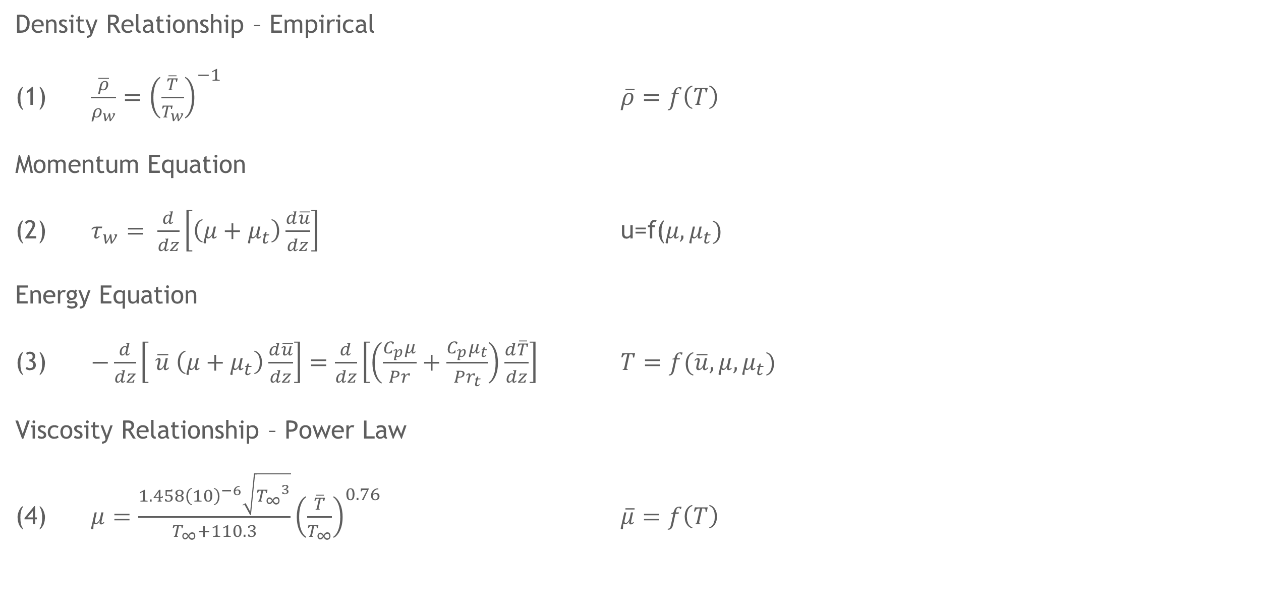
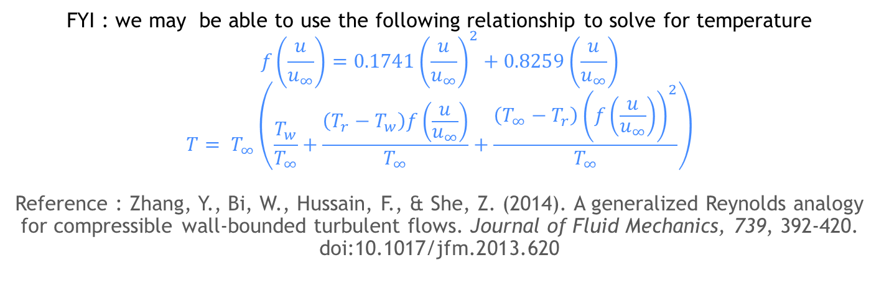
Simplified 1-D Governing Equation
Density Relationship – Empirical
(1) $\frac{\overline{ρ}}{ρ_{w}}={\left(\frac{\overline{T}}{T_{w}}\right)}^{−1}$ $\overline{ρ}=f\left(T\right)$
Momentum Equation
(2) $τ_{w}= \frac{d}{dz}\left[\left(μ+μ_{t}\right)\frac{d\overline{u}}{dz}\right]$ u=f($μ,μ_{t})$
Energy Equation
(3) $−\frac{d}{dz}\left[ \overline{u} \left(μ+μ_{t}\right)\frac{d\overline{u}}{dz}\right]=\frac{d}{dz}\left[\left(\frac{C_{p}μ}{Pr}+\frac{C_{p}μ_{t}}{{Pr}_{t}}\right)\frac{d\overline{T}}{dz}\right]$ $T=f(\overline{u},μ,μ_{t})$
Viscosity Relationship – Power Law
(4) $μ=\frac{1.458{\left(10\right)}^{−6}\sqrt{{T_{∞}}^{3}}}{T_{∞}+110.3}{\left(\frac{\overline{T}}{T_{∞}}\right)}^{0.76}$ $\overline{μ}=f\left(T\right)$
Dependent Variables
$ρ=density$ $\left(kg/m^{3}\right)$
$T=Temperature$ $\left(K\right)$
$u=streamwise velocity$ $\left(\frac{m}{s}\right)$
$μ=dynamic viscosity$ $\left(\frac{kg}{m∙s}\right)$
$μ_{t}=turbulent viscosity$ $\left(\frac{kg}{m∙s}\right)$
$k=turbulent intensity$ (m²/s²)
$ω=specific dissipation rate$ (1/s)
Subscript
$∞=freestream$
$w=wall$
FYI : we may be able to use the following relationship to solve for temperature
$$f\left(\frac{u}{u_{∞}}\right)=0.1741{\left(\frac{u}{u_{∞}}\right)}^{2}+0.8259\left(\frac{u}{u_{∞}}\right)$$
$$T= T_{∞}\left(\frac{T_{w}}{T_{∞}}+\frac{\left(T_{r}−T_{w}\right)f\left(\frac{u}{u_{∞}}\right)}{T_{∞}}+\frac{\left(T_{∞}−T_{r}\right){\left(f\left(\frac{u}{u_{∞}}\right)\right)}^{2}}{T_{∞}}\right)$$
Reference : Zhang, Y., Bi, W., Hussain, F., & She, Z. (2014). A generalized Reynolds analogy for compressible wall-bounded turbulent flows. Journal of Fluid Mechanics, 739, 392-420. doi:10.1017/jfm.2013.620

Slide 2
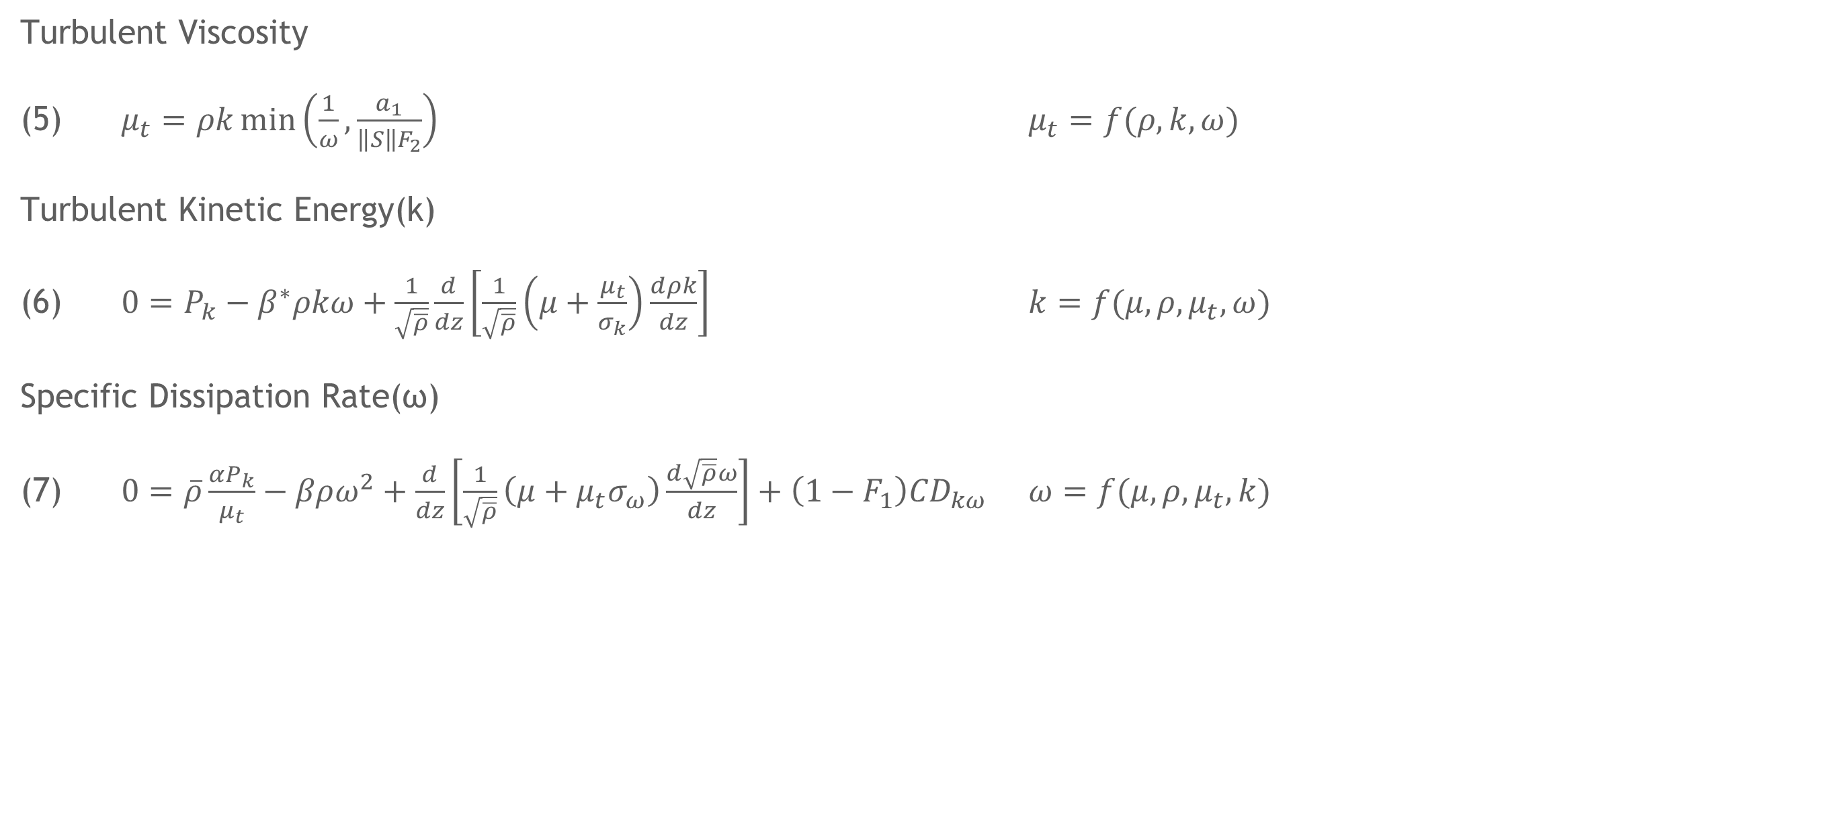
Simplified 1-D Governing Equation
Turbulent Viscosity
(5) $μ_{t}=ρk\min\left(\frac{1}{ω},\frac{a_{1}}{\left\|S\right\|F_{2}}\right)$ $μ_{t}=f(ρ,k,ω)$
Turbulent Kinetic Energy(k)
(6) $0=P_{k}−β^{∗}ρkω+\frac{1}{\sqrt{\overline{ρ}}}\frac{d}{dz}\left[\frac{1}{\sqrt{\overline{ρ}}}\left(μ+\frac{μ_{t}}{σ_{k}}\right)\frac{dρk}{dz}\right]$ $k=f(μ,ρ,μ_{t},ω)$
Specific Dissipation Rate(ω)
(7) $0=\overline{ρ}\frac{αP_{k}}{μ_{t}}−βρω^{2}+\frac{d}{dz}\left[\frac{1}{\sqrt{\overline{ρ}}}\left(μ+μ_{t}σ_{ω}\right)\frac{d\sqrt{\overline{ρ}}ω}{dz}\right]+\left(1−F_{1}\right){CD}_{kω}$ $ω=f(μ,ρ,μ_{t},k)$

Slide 3
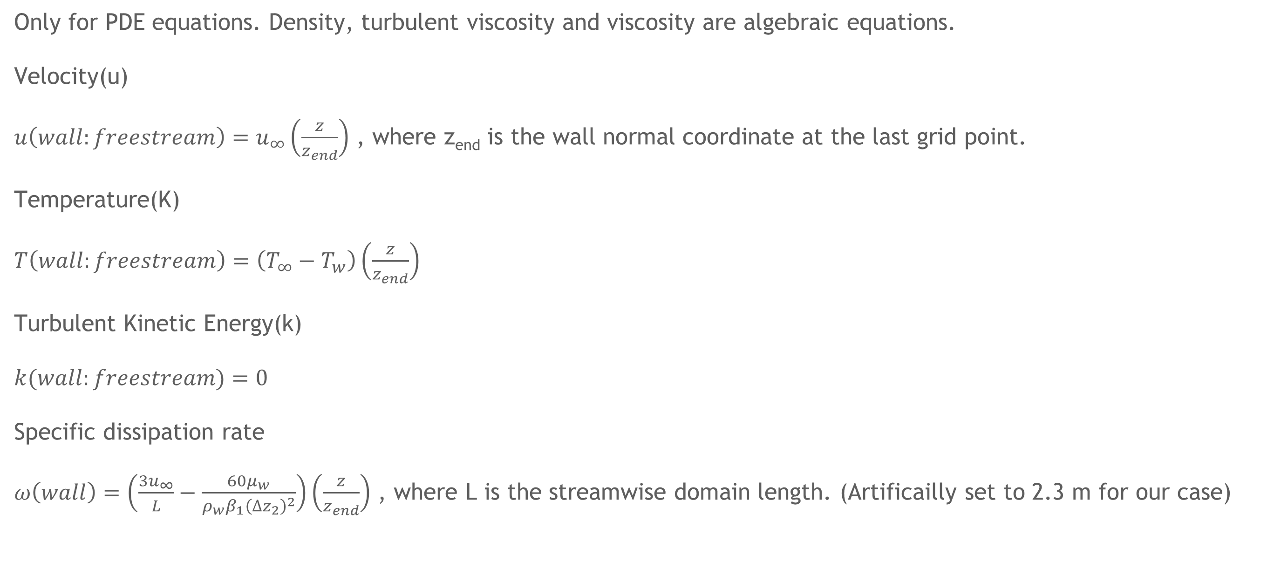
Initial Condition
Only for PDE equations. Density, turbulent viscosity and viscosity are algebraic equations.
Velocity(u)
$u\left(wall:freestream\right)=u_{∞}\left(\frac{z}{z_{end}}\right)$ , where z_{end} is the wall normal coordinate at the last grid point.
Temperature(K)
$T\left(wall:freestream\right)=\left(T_{∞}−T_{w}\right)\left(\frac{z}{z_{end}}\right)$
Turbulent Kinetic Energy(k)
$k(wall:freestream)=0$
Specific dissipation rate
$ω\left(wall\right)=\left(\frac{3u_{∞}}{L}−\frac{60μ_{w}}{ρ_{w}β_{1}{\left({∆z}_{2}\right)}^{2}}\right)\left(\frac{z}{z_{end}}\right)$ , where L is the streamwise domain length. (Artificailly set to 2.3 m for our case)

Slide 4
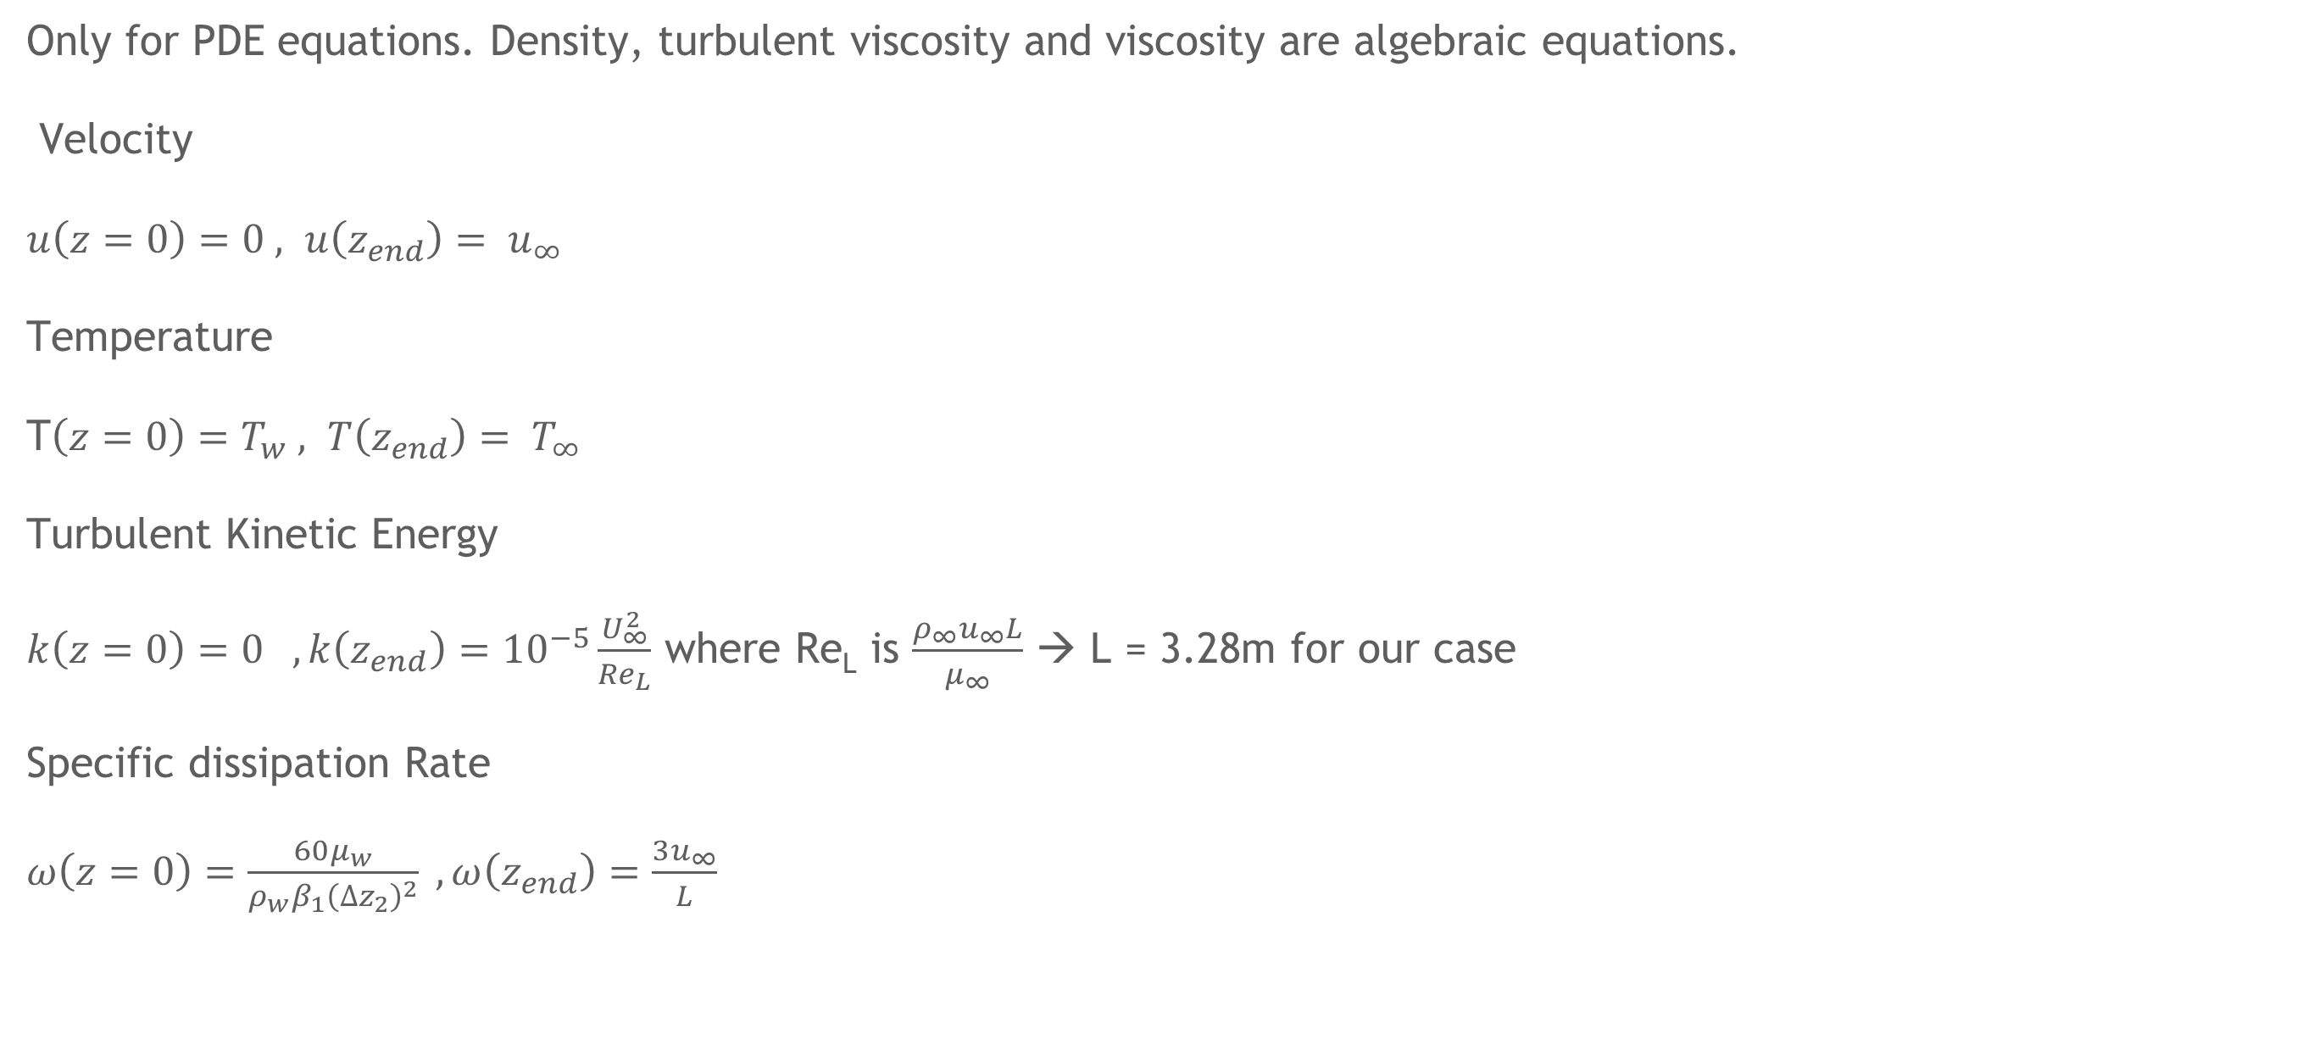
Boundary Condition
Only for PDE equations. Density, turbulent viscosity and viscosity are algebraic equations.
Velocity
$u\left(z=0\right)=0 , u\left(z_{end}\right)= u_{∞}$
Temperature
T$\left(z=0\right)=T_{w} , T\left(z_{end}\right)= T_{∞}$
Turbulent Kinetic Energy
$k\left(z=0\right)=0 , k\left(z_{end}\right)={10}^{−5}\frac{U_{∞}^{2}}{{Re}_{L}}$ where Re_{L} is $\frac{ρ_{∞}u_{∞}L}{μ_{∞}}$ → L = 3.28m for our case
Specific dissipation Rate
$ω\left(z=0\right)=\frac{60μ_{w}}{ρ_{w}β_{1}{\left({∆z}_{2}\right)}^{2}} , ω\left(z_{end}\right)=\frac{3u_{∞}}{L}$

Slide 5
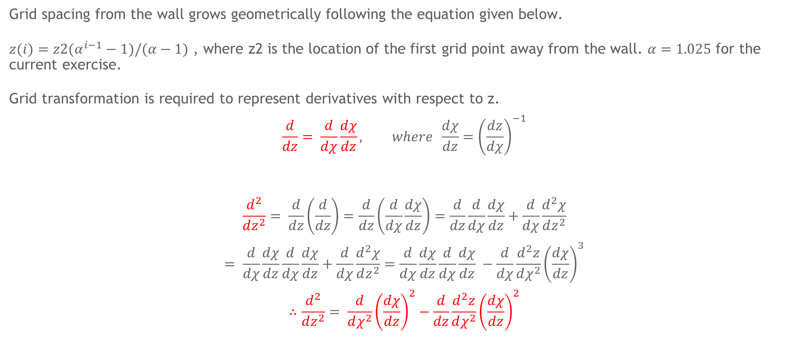
Grid Transformation
Grid spacing from the wall grows geometrically following the equation given below.
$z(i)=z2(α^{i−1}−1)/(α−1)$ , where z2 is the location of the first grid point away from the wall. $α=1.025$ for the current exercise.
Grid transformation is required to represent derivatives with respect to z.
$$\frac{d}{dz}= \frac{d}{dχ}\frac{dχ}{dz}, where \frac{dχ}{dz}={\left(\frac{dz}{dχ}\right)}^{−1}$$
$$\frac{d^{2}}{dz^{2}}= \frac{d}{dz}\left(\frac{d}{dz}\right)=\frac{d}{dz}\left(\frac{d}{dχ}\frac{dχ}{dz}\right)=\frac{d}{dz}\frac{d}{dχ}\frac{dχ}{dz}+\frac{d}{dχ}\frac{d^{2}χ}{dz^{2}}$$
$$= \frac{d}{dχ}\frac{dχ}{dz}\frac{d}{dχ}\frac{dχ}{dz}+\frac{d}{dχ}\frac{d^{2}χ}{dz^{2}}=\frac{d}{dχ}\frac{dχ}{dz}\frac{d}{dχ}\frac{dχ}{dz} −\frac{d}{dχ}\frac{d^{2}z}{dχ^{2}}{\left(\frac{dχ}{dz}\right)}^{3}$$
$$∴\frac{d^{2}}{dz^{2}}= \frac{d}{dχ^{2}}{\left(\frac{dχ}{dz}\right)}^{2}−\frac{d}{dz}\frac{d^{2}z}{dχ^{2}}{\left(\frac{dχ}{dz}\right)}^{2}$$

Slide 6
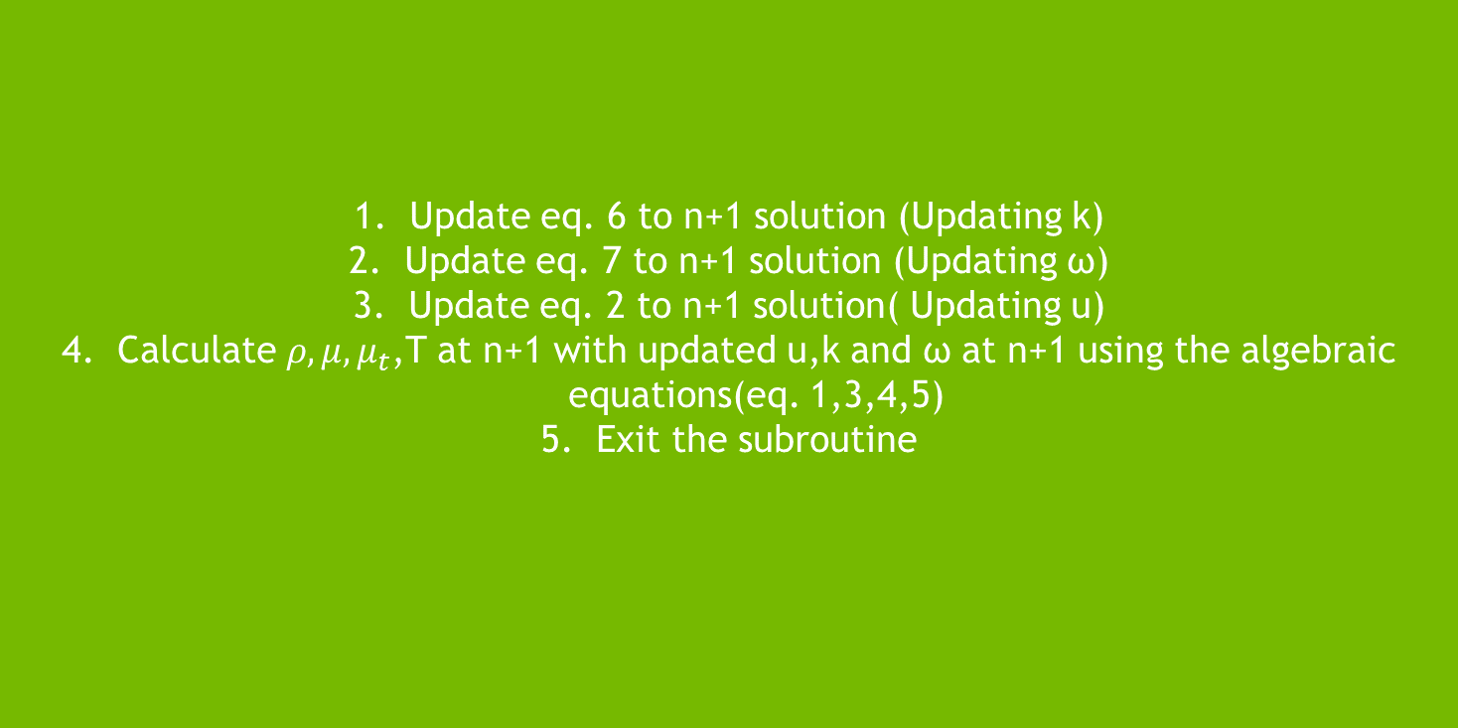

Code Structure
Initialize u,T,ρ,$μ$,$μ_{t}$,k,$ω$
Update eq. 6 to n+1 solution (Updating k)
Update eq. 7 to n+1 solution (Updating ω)
Update eq. 2 to n+1 solution( Updating u)
Calculate $ρ,μ,μ_{t}$,T at n+1 with updated u,k and ω at n+1 using the algebraic equations(eq. 1,3,4,5)
Exit the subroutine
Initialize Grid
GMRES or SUR
Check Residual
Post-process

Slide 7
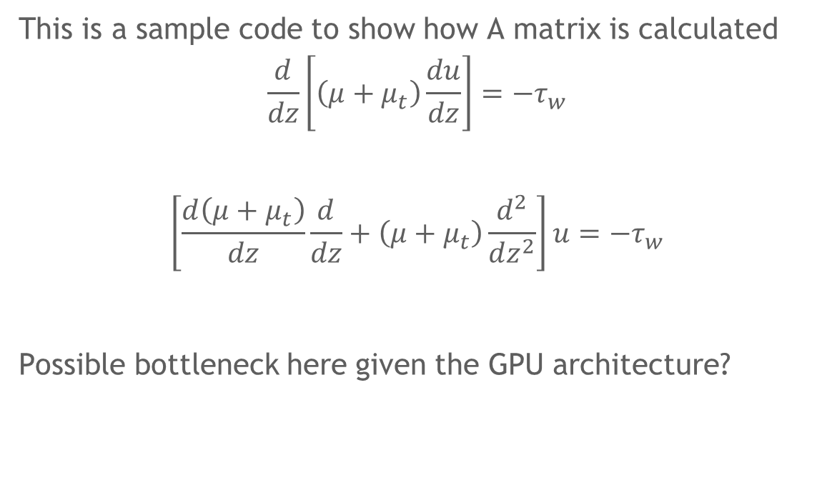
Sample Code
Momentum
mueff = mu+mut A=mesh.d2dz2.copy()
dmueffdz = mesh.ddz@mueff
for m in range(0,p.nz):
A[m,:] = mesh.d2dz2[m,:]*mueff[m] + mesh.ddz[m,:]*dmueffdz[m]
This is a sample code to show how A matrix is calculated
$$\frac{d}{dz}\left[\left(μ+μ_{t}\right)\frac{du}{dz}\right]=−τ_{w}$$
$$\left[\frac{d\left(μ+μ_{t}\right)}{dz}\frac{d}{dz}+\left(μ+μ_{t}\right)\frac{d^{2}}{dz^{2}}\right]u=−τ_{w}$$
Possible bottleneck here given the GPU architecture?

Slide 8
Sample Code
def solveEqn(x,A,b,omega,igmres):
# import pdb
import cupy as cp
import cupyx.scipy.sparse.linalg as cpx
n = cp.size(x)
x_new = x.copy()
# add boundary conditions
tmp2 = x[0]*A[1:n-1,0]
b[0] = b[0] - tmp2[0,0]
tmp2 = x[n-1]*A[1:n-1,n-1]
b[n-3] = b[n-3]- tmp2[n-3,0]
sol = cpx.gmres(A[1:n-1, 1:n-1],b,x[1:n-1], tol=1e-6, maxiter=1 )
x_new[1:-1] = sol[0]
return x_new
BC/GMRES Ax=b Solver
This is a sample code to show how Dirichlet BC is applied and Ax=b solver is called.

